Slide 1
J. P. DAWER INSTITUTE OF INFORMATION AND COMMUNICATION TECHNOLOGY Project Submission – 2 (606) (January-2026) ...::: Project Name :::... LEGAL CASE MANAGEMENT SYSTEM ...::: Guided By :::... Ms. Parul Patel ...::: Company :::... MountainDriven Technologies ...::: Prepared By :::...
Roll No. | Name
185 | Pathan Samir
198 | Rangoonwala Manan
227 | Talior Utsav

Slide 2
Project Definition
Legal Case Management System is a web-based application designed to manage, track, and organize legal cases in a digital manner. The system helps lawyers, law firms, court staff, and clients to maintain case records, hearing schedules, documents, and case status efficiently. It reduces manual paperwork and improves accuracy, security, and productivity in legal operations.
Purpose of the Project
To digitalize legal case management processes.
To reduce paperwork and manual errors.
To provide centralized case tracking.
To ensure secure storage of legal documents.
Project Objectives
Maintain complete case lifecycle information.
Improve efficiency of lawyers and court staff.
Provide quick access to case history and documents.
Send reminders for hearings and deadlines.
Scope of the Project
The system covers case registration, client management, document management, hearing schedules, case status tracking, and user management. It does not include judicial decision-making processes.
Target Users
Lawyers
Law Firms
Court Staff
Clients
System Modules
User Management Module
Case Management Module
Client Management Module
Hearing & Schedule Module
Document Management Module
Notification & Reminder Module
7. Functional Requirements

Slide 3
User registration and login.
Add, update, and delete case records.
Upload and manage legal documents.
Schedule hearings and deadlines.
Search and filter case details.
8. Database Design (Field – Type – Description)
Table: Users
Field | Type | Description
user_id (PK) | INT | Unique user identification
username | VARCHAR | Login username
password_hash | VARCHAR | Encrypted password
role | VARCHAR | User role
email | VARCHAR | User email address
phone | VARCHAR | Contact number
created_at | DATETIME | Account creation date
Table: Clients
Field | Type | Description
client_id (PK) | INT | Unique client identification
name | VARCHAR | Client full name
address | TEXT | Client address
phone | VARCHAR | Client contact number
email | VARCHAR | Client email
case_count | INT | Total cases registered
created_at | DATETIME | Client registration date
Table: Cases
Field | Type | Description
case_id (PK) | INT | Unique case identification
client_id (FK) | INT | Linked client ID
title | VARCHAR | Case title
description | TEXT | Case details
case_type | VARCHAR | Type of case
status | VARCHAR | Current case status
filing_date | DATE | Case filing date

Slide 4
Table: Hearings
hearing_id (PK) | INT | Unique hearing identification
case_id (FK) | INT | Related case ID
hearing_date | DATE | Scheduled hearing date
judge_name | VARCHAR | Judge name
remarks | TEXT | Hearing remarks
Table: Documents
Field | Type | Description
document_id (PK) | INT | Unique document identification
case_id (FK) | INT | Related case ID
doc_name | VARCHAR | Document name
doc_type | VARCHAR | Type of document
file_path | VARCHAR | File storage path
uploaded_at | DATETIME | Upload date and time
Table: CaseHistory
Field | Type | Description
history_id (PK) | INT | Unique history identification
case_id (FK) | INT | Related case ID
status | VARCHAR | Case status
remarks | TEXT | Status remarks
updated_at | DATETIME | Last update date
Table: Judgement
Field | Type | Description
judgement_id (PK) | INT | Unique judgement identification
case_id (FK) | INT | Related case ID
judgement_text | TEXT | Judgement details
judgement_date | DATE | Judgement date
judge_name | VARCHAR | Judge name

Slide 5
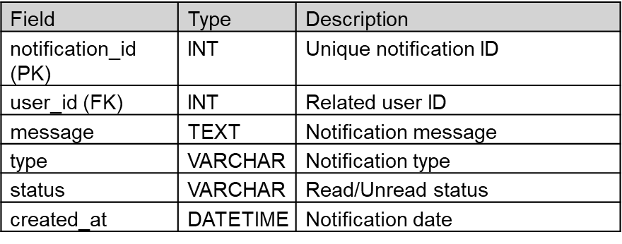
Table: Notification
9. Technology Stack
Frontend: HTML, CSS, JavaScript, Bootstrap
Backend: Python Flask
Database: MongoDB / MySQL
Server: Iocalhost
10. Conclusion
Legal Case Management System provides an efficient, secure, and organized way to manage legal cases. The system improves productivity, reduces manual work, and supports digital transformation in the legal sector.

Slide 6
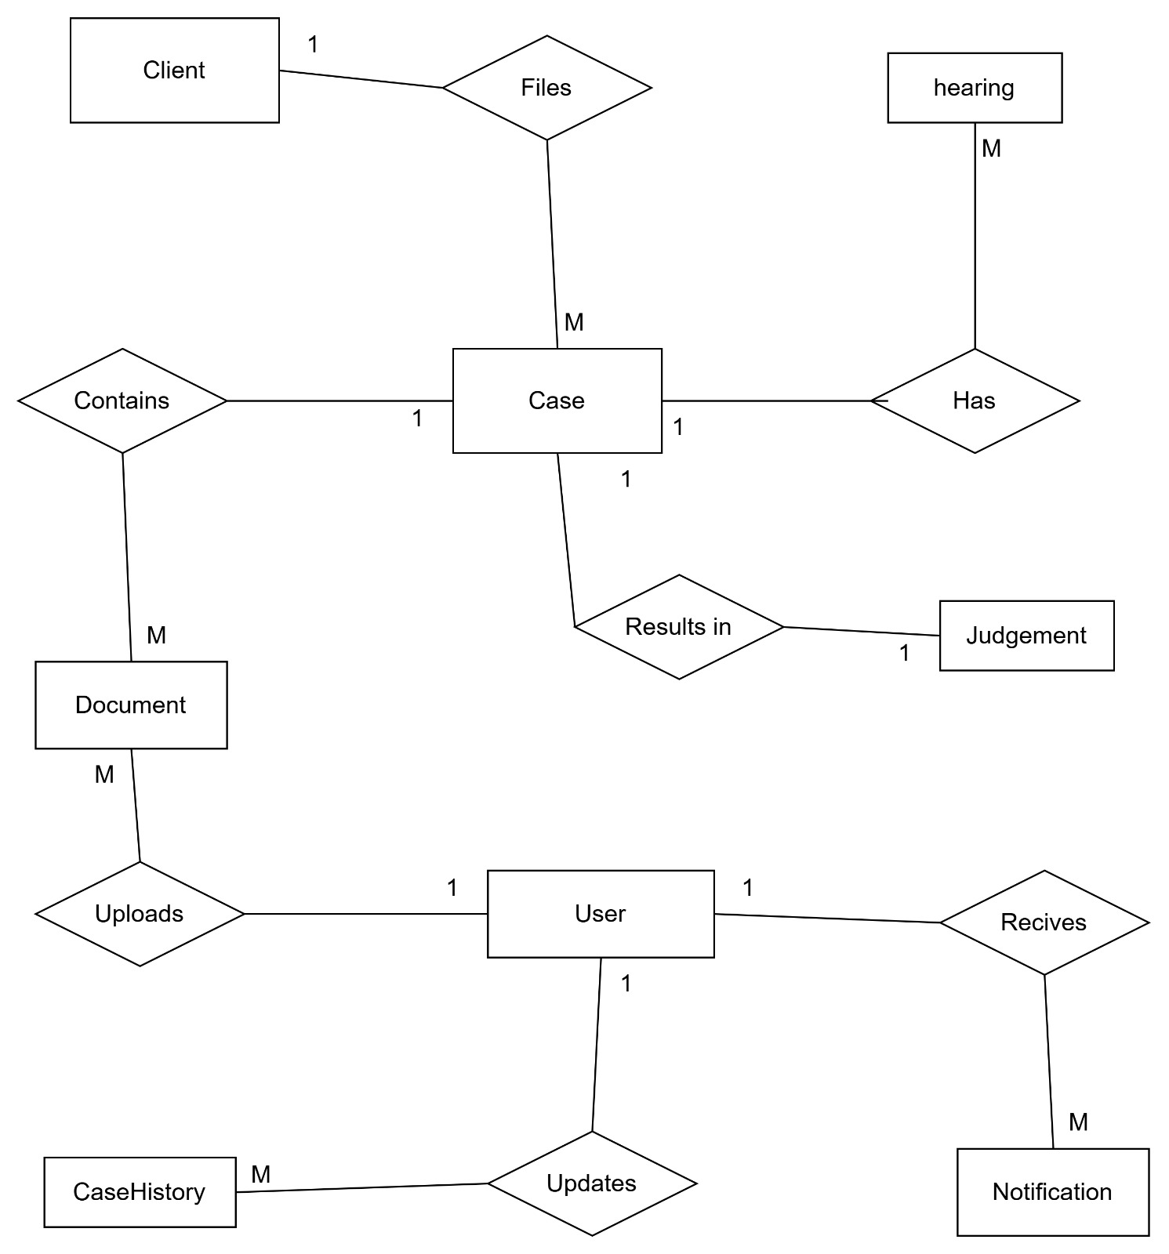
ER DIAGRAM

Slide 7
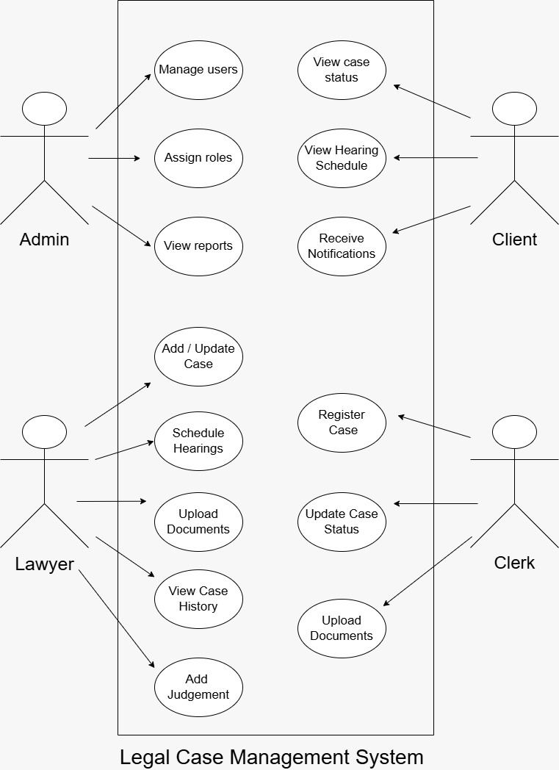
USE CASE DIAGRAM

